Slide 1
Food conservation
Professor Dr. Hungwen Li
Fall 2019 : CMPE 273
Team 14
Farhan Bhoraniya (014506531)
Shraddha Nayak (014008943)
Manasa Hari (013855075)
Date: 11/12/2019
Throwing away food is like stealing from the table of those who are poor and hungry.
- Pope Francis

Slide 2
Executive Summary
Many people have to sleep on empty stomach because of poverty.
On the other hand, many homes and restaurants waste a lot of food.
This project aims to redistribute the excess food in order to reduce this hunger problem.

Slide 3
Goals
Reduce food wastage by redistributing the excess food.
Help fight hunger problems.
Collect excess food from people.
Store this food in fresh conditions.
Distribute this food to other people on needy basis.

Slide 4
Problem
Hunger
Major problem in the United States and all over the world.
Many surveys show that actual problem behind the hunger is the irregular utilization of food.
If we can redistribute the excess food, we can significantly reduce the hunger problem.

Slide 5
Deliverable
A web portal.
Technology Stack
UI : React JS, HTML5, CSS3, JavaScript
Framework : J2EE web frameworks (Jersey)
Database: MongoDB
Server : Apache Tomcat

Slide 6
Schedule
S.No | Date | Milestone
1. | 10/08/2019 | Project Proposal
2. | 10/15/2019 | Database and Server Setup
3. | 10/22/2019 | Web Portal Deployment
4. | 10/29/2019 | System Testing
5. | 11/05/2019 | SIT Testing
6. | 11/12/2019 | Project Design
7. | 11/19/2019 | Testing UAT
8. | 11/26/2019 | Project Report & Presentation

Slide 7
Solution
To build a web application where people can donate and borrow food.
Set up a network to collect excess food and distribute it among the needy.

Slide 8
Implementation
Organizations, individuals and volunteers need to register in the portal.
When a user is authenticated, he/she can add a list of food items that he wants to donate and select a drop off point.
When volunteers are successfully logged in, they can select their pick up points and deliver the food to needy.
Once delivered, it will be updated in the system.
The system will maintain the details of all the food logged in.

Slide 9
Sample Use Cases
#1 Donate excess food
Example: Joe, who lives San Jose downtown has just invited some guests for lunch. There is still some more food available after the lunch. So he decides to donate this food. He registers into this application and gives all the necessary details. It’s just that simple.
#2 Distribute the excess food
Example: Tom, who is a hungry, logs into the portal to see the list of all food available at a specific pick up counter. He then decides to take sufficient food. He also wants to share some more food to his friends in need.

Slide 10
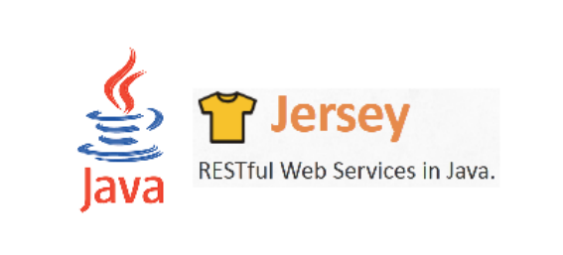


TECHNOLOGY STACK

Slide 11
DATABASE DESIGN

Slide 12
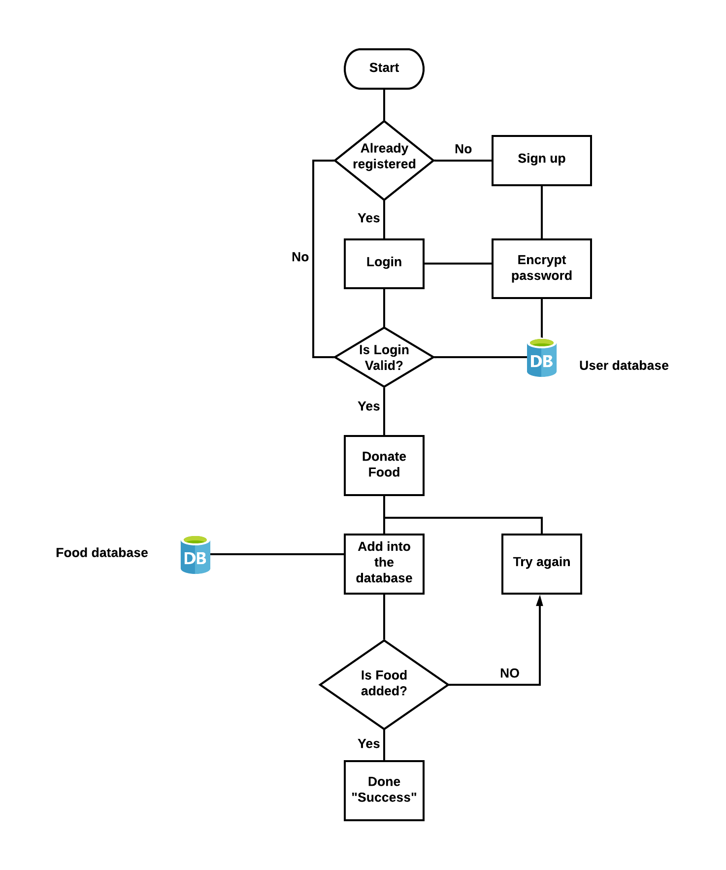
DONOR WORKFLOW

Slide 13
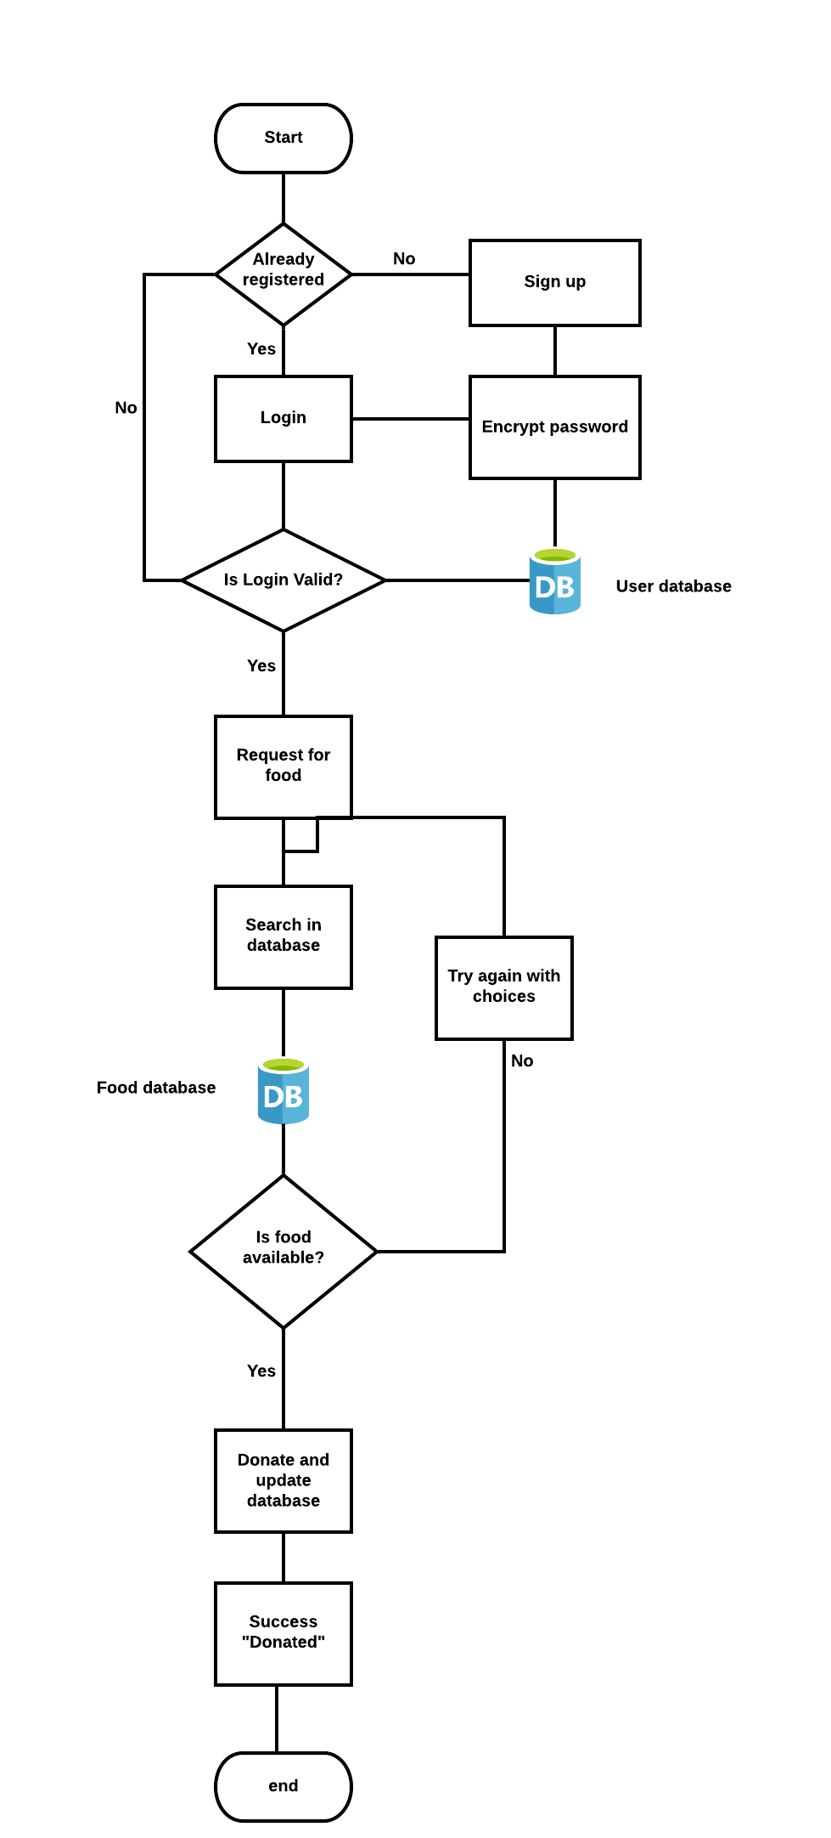
RECIPIENT WORKFLOW

Slide 14
Benefits
Reduce wastage of food.
Fight against hunger.
Volunteering opportunities.

Slide 15
Summary
Using this web application we can reach our goal, which is to eliminate hunger and reduce food wastage.

